Slide 1
Meeting 7-7-2014 App Design
Everardo Camacho

Slide 2
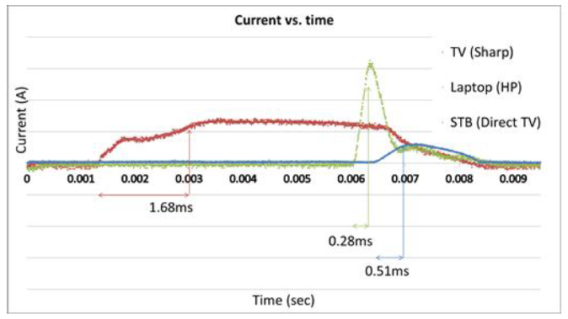
App Design
Data fetched from server, stored in sqlite Graph on interface Checkbox buttons for different appliances Refresh Data
Checkboxes of different appliances

